Slide 1


Danny Suradja
September 25 2024

Slide 2

Outline
Executive Summary
Introduction
Methodology
Results
Conclusion
Appendix

Slide 3
Executive Summary
Summary of methodologies
SPACEX API and Falcon9 launch data from WIKIPEDIA are used to retrieve information
Perform data cleaning and wrangling to retrieve Falcon9 data with Python
Utilize SQL queries to look into insights from launch data
Utilize Folium to map out launch sites and help visualize success/fail results
Utilize matplotlib visualization to gain insights of the trend between each feature with relation to success/fail of first stage landing
Summary of all results

Slide 4
Introduction
SpaceX is a company that has been developing and building rockets to outer space. Rocket launch can be very expensive. Providers have historically listed cost upward of 165 million dollars for a launch, while SpaceX advertises lower amount in their website: 62 million dollars. Part of this lower price is due to SpaceX being able to reuse the first stage after their rockets launch.
In this project, we explore past historical data of Falcon9 first stage landing and build a classification model to predict whether future Falcon9 first stage landings will be successful.

Slide 5

Section 1

Slide 6
Methodology
Executive Summary
Data collection methodology:
Request past launch data from SpaceX API, extracting data related to Falcon9 launch
Wikipedia data of historical Falcon9 launch
Perform data wrangling
One hot encoding on Falcon9 first stage Success/Fail features
Perform exploratory data analysis (EDA) using visualization and SQL
Perform interactive visual analytics using Folium and Plotly Dash
Perform predictive analysis using classification models
Utilize Logistic Regression, Support Vector Machine, K-Nearest Neighbors, and Classification Tree to determine which methodology provide the highest accuracy to the set

Slide 7
Data Collection – SpaceX API
Add the GitHub URL of the completed SpaceX API calls notebook (must include completed code cell and outcome cell), as an external reference and peer-review purpose
SpaceX API
GET request to SpaceX API
Receive and Parse JSON data
Convert JSON to dataframe

Slide 8
Data Collection - Scraping
Add the GitHub URL of the completed web scraping notebook, as an external reference and peer-review purpose
Identify Falcon9 data. In this case using Wikipedia
Request Falcon9 data from Wikipedia URL with BeautifulSoup
Extract column and variable names
Parse HTML tables and convert to dataframe

Slide 9
Data Wrangling
Once data has been converted in dataframe, we identify any missing values in the dataframe. We tried getting more information about some features such as number of launch from different Launch Site and Orbits. Then using one-hot-encoding on the Outcome feature, we determine whether each launch is considered Success or Fail and append onto the dataframe
Add the GitHub URL of your completed data wrangling related notebooks, as an external reference and peer-review purpose
Identify missing values in dataframe
Obtain more information from features in data
One hot encoding to determine whether each record is success/fail
Append this success/fail feature to existing dataframe

Slide 10
EDA with Data Visualization
Some interesting charts we looked into:
Scatterplot of Flight Number vs Payload Mass to identify whether there are any relation between flight numbers and mass to success of the return of first stage
Scatterplot of Flight Number vs Launch site to identify success rate of each launch site with respect to each flight number
Scatterplot of Payload Mass vs Launch Site to identify if different payload mass at each launch site contribute to success/fail of first stage return
Barplot of Orbit Type with Success Rate to determine which orbit type has the best success rate of return
Scatterplot of Flight Number vs Orbit to identify success rate of each orbit with respect to flight number
Scatterplot of Payload Mass vs Orbit to identify if different payload mass contribute to success/fail with each orbit type
Lineplot of Year and Success Rate to visualize if there are any improvements throughout the years
Summarize what charts were plotted and why you used those charts
Add the GitHub URL of your completed EDA with data visualization notebook, as an external reference and peer-review purpose

Slide 11
EDA with SQL
SQL queries performed in this project:
SELECT to retrieve data
WHERE, LIKE, BETWEEN to filter through columns/entries
DISTINCT to list each unique launch site
GROUP BY to group by the data by specific columns
AVG, SUM to perform arithmetic on data
Add the GitHub URL of your completed EDA with SQL notebook, as an external reference and peer-review purpose

Slide 12
Build an Interactive Map with Folium
Circles: mark the launch sites
Markers: mark each record whether they are successful/failed first stage
Lines: mark a line between launch site and nearest coastline/railway/highway/city to visualize proximity to the launch site
Add the GitHub URL of your completed interactive map with Folium map, as an external reference and peer-review purpose

Slide 13
Build a Dashboard with Plotly Dash
Pie chart showing success/fail of all sites and each unique launch site
Scatterplot between Payload Mass and Success Rate to show relationship between payload and success rate for each booster version category. We added an interactive scale on payload mass to help visualize different payload mass
Add the GitHub URL of your completed Plotly Dash lab, as an external reference and peer-review purpose

Slide 14
Predictive Analysis (Classification)
We separated the data into training set and test set to build our model
Using Logistic Regression, Support Vector Machine, K-Nearest Neighbor, and Classification Tree, we build models based on training set and see how accurate they are in the test sets. We measure the accuracy to determine which models perform the best out of them all.
Add the GitHub URL of your completed predictive analysis lab, as an external reference and peer-review purpose
Retrieve data and convert to dataframe
One hot encoding on specified features
Split dataset into train and test sets
Build models using different approach on test sets, and fit into test sets
Check for accuracy

Slide 15
Results
Exploratory data analysis results
Interactive analytics demo in screenshots
Predictive analysis results

Slide 16

Section 2

Slide 17
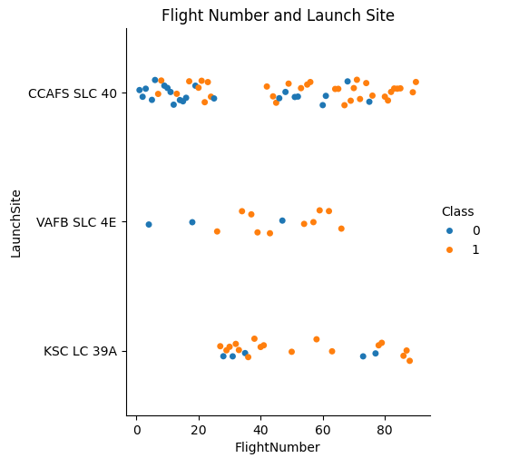
Flight Number vs. Launch Site
More successful landings on later flights, more failure on earlier flights
Landings seem to be have higher success rate in VAFB SLC 4E and KSC LC 39A, but no patters can be found in CCAFS SLC 40

Slide 18
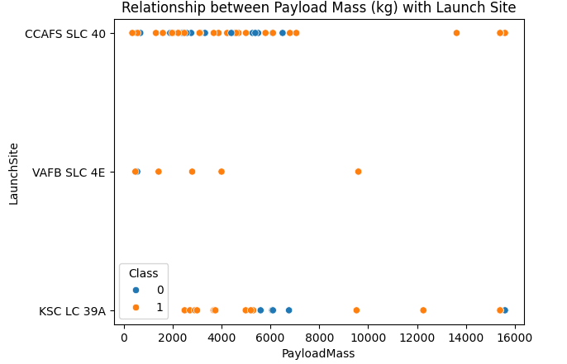
Payload vs. Launch Site
No payload greater than 10000kg at VAFB SLC 4E
No strong evidence can be found if higher or lower payload mass affect success rate

Slide 19
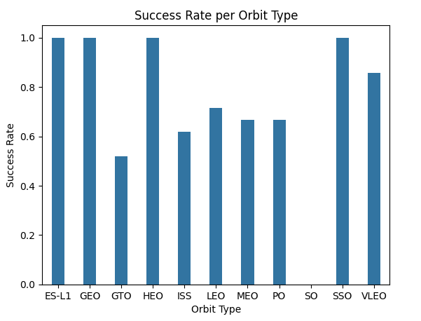
Success Rate vs. Orbit Type
ES-L1, GEO, HEO, SSO have 100% success rate while SO has 0% success rate

Slide 20
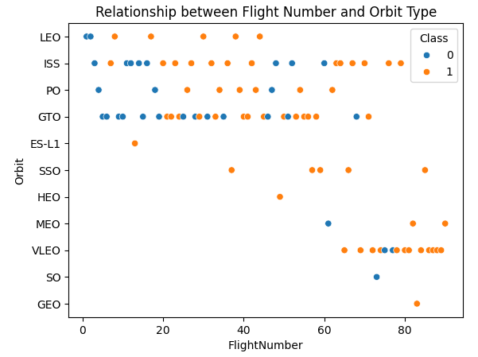
Flight Number vs. Orbit Type
ES-L1, HEO, SO, GEO only have 1 launch data, so success rate cannot be strongly determined at these locations.
Later flight records showing more success with LEO orbit, but the rest of orbits are inclocusive

Slide 21
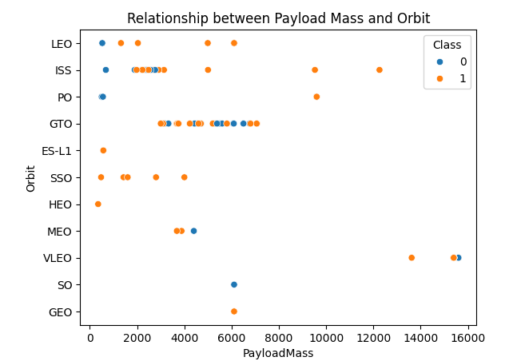
Payload vs. Orbit Type
With higher payload, PO, LEO, ISS orbits seem to have more success.
Rest are inconclusive due to lack of records or varying results at the orbit

Slide 22
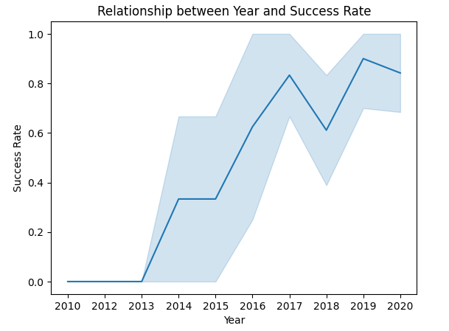
Launch Success Yearly Trend
Success rate generally showing positive trend as years go by

Slide 23
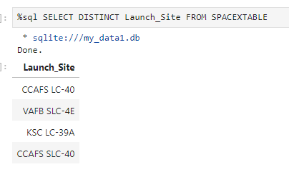
All Launch Site Names
SELECT DISTINCT Launch_Site FROM SPACEXTABLE: retrieve unique entry in “Launch_Site” column from “SPACEXTABLE” dataframe

Slide 24
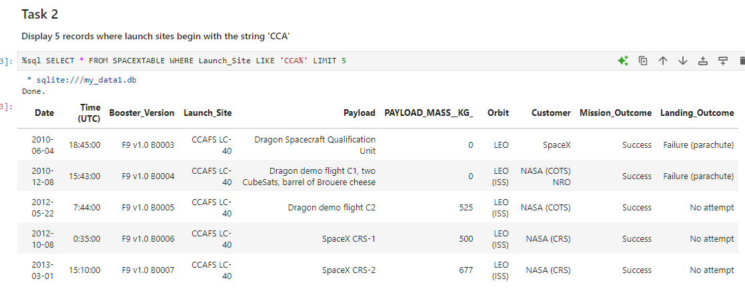
Launch Site Names Begin with 'CCA'
Retrieve all columns from SPACEXTABLE dataframe; filtering through the “Launch_Site” column to get entries that start with “CCA” and limit the shown results to 5 rows

Slide 25
Total Payload Mass
Calculate the total payload carried by boosters from NASA
Present your query result with a short explanation here

Slide 26
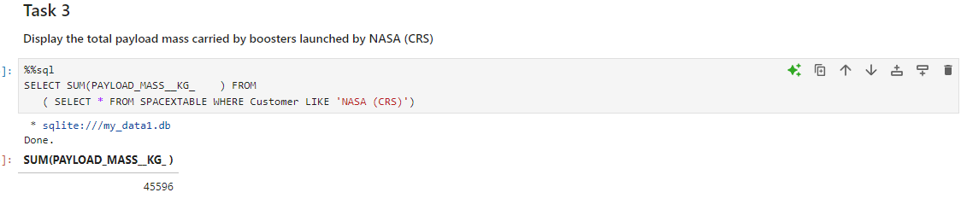
Average Payload Mass by F9 v1.1
Retrieve data from “SPACEXTABLE” dataframe where the “Customer” column have entries “NASA (CRS)”. And then retrieve the sum of each entry in “PAYLOAD_MASS_KG” column

Slide 27
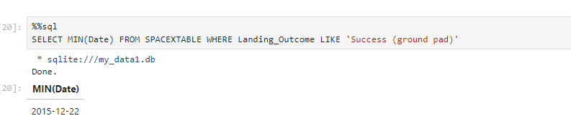
First Successful Ground Landing Date
Retrieve data from “SPACEXTABLE” dataframe where the “Landing_Outcome” column entry is “Success (ground pad)”. And then retrieve the minimum date (i.e. the first date)

Slide 28
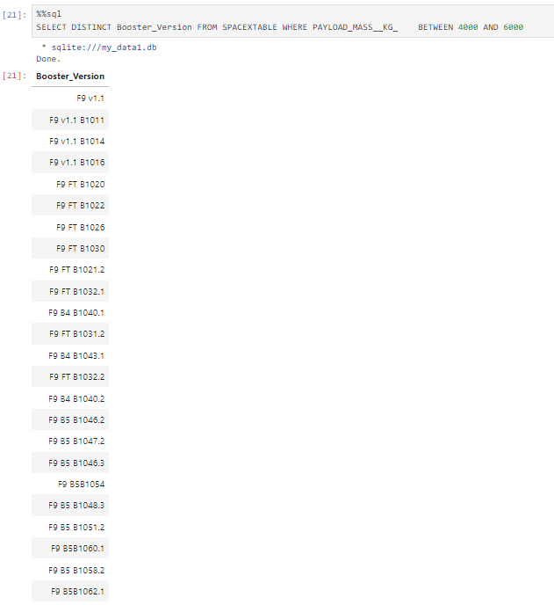
Successful Drone Ship Landing with Payload between 4000 and 6000
Retrieve unique Booster_Version entry from “SPACEXTABLE” dataframe, filtering the “PAYLOAD_MASS_KG” column to find entries between 4000 and 6000

Slide 29
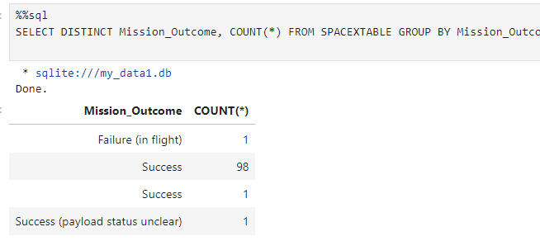
Total Number of Successful and Failure Mission Outcomes
Retrieve the count of each unique entry of ‘Mission_Outcome’ columns from “SPACEXTABLE” dataframe where the dataframe has been grouped by the “Mission_Outcome” column entry

Slide 30
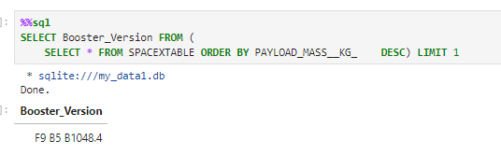
Boosters Carried Maximum Payload
Sort the “PAYLOAD_MASS_KG” column from “SPACEXTABLE” dataframe in descending order. Retrieve the “Booster_Version” column and show the output only for the first entry

Slide 31
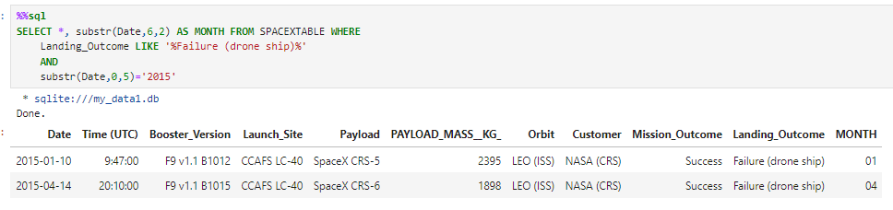
2015 Launch Records
Filter through the “SPACEXTABLE” dataframe in which the “Landing_Outcome” entry is showing “Failure (drone ship) and the “Date” column starts with 2015 to show 2015 launch records. And then create another column called “MONTH” in which the entry is the sixth and seventh character on “Date” column.

Slide 32
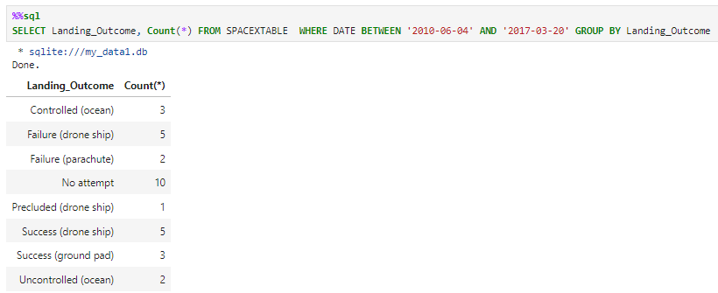
Rank Landing Outcomes Between 2010-06-04 and 2017-03-20
Filter through the “SPACEXTABLE” dataframe in which the “DATE” column entry is between 2010-06-04 and 2017-03-20, and then group the dataframe based on “Landing_Outcome” column. Retrieve the count of each entry in “Landing_Outcome”

Slide 33

Section 3

Slide 34
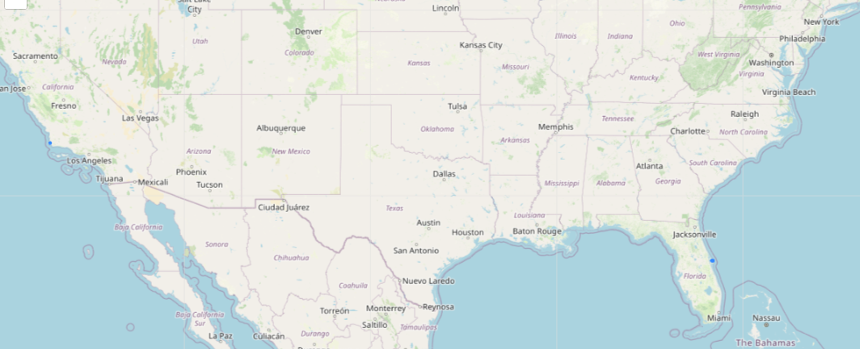
Launch Site Locations
The blue dots represent locations of launch site. There is one site located in the west coast and another on in the east coast. These launch sites are relatively closed to coastlines

Slide 35
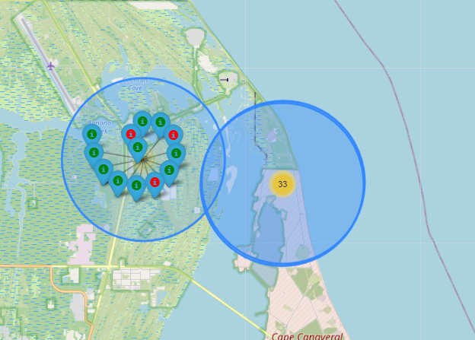
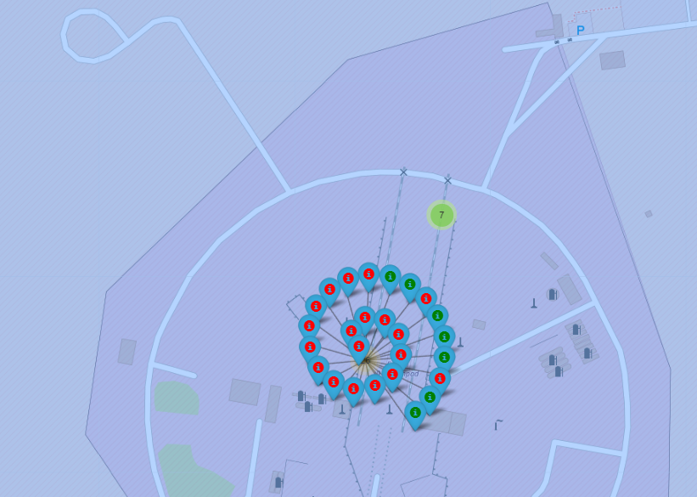
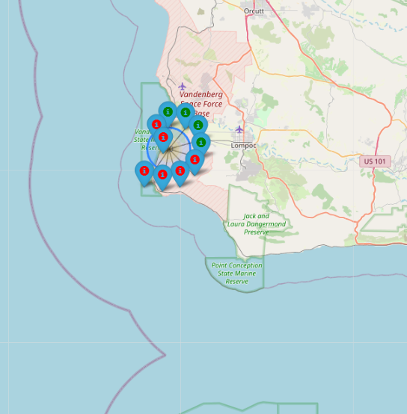
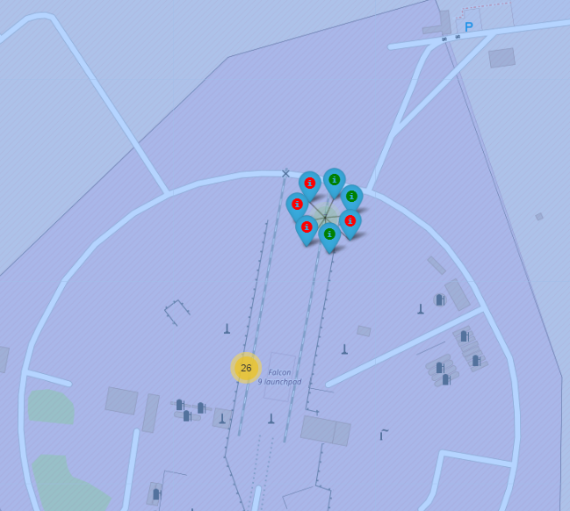
Success/Fail Markers at each Launch Site
Out of all 4 launch site locations, the top left picture shows the site with the highest success rate out of all 4. The results of the rest of launch sites are mixed. The top left picture is showing a launch site at the east coast

Slide 36
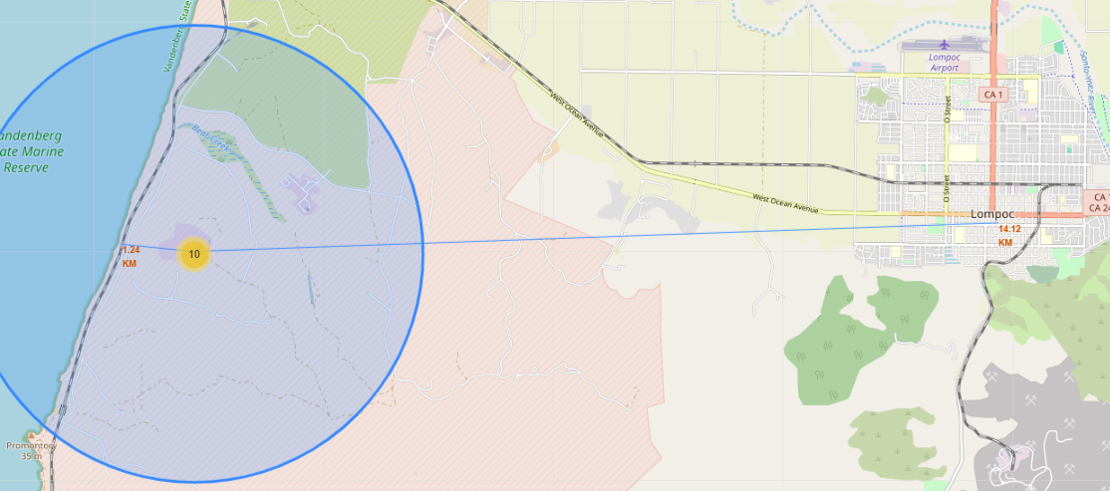
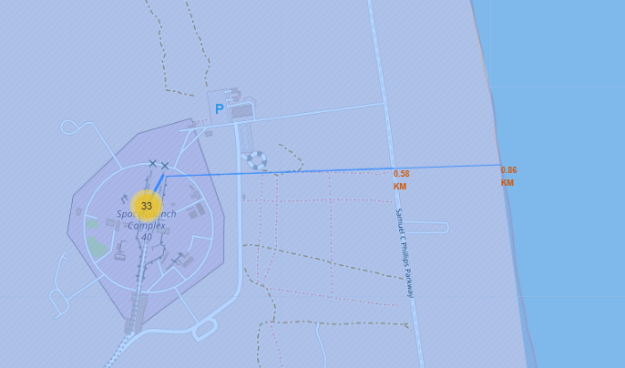
Distance from Launch Site to its Proximities
The screenshots are showing the closest distance between launch sites to proximities such as coastline, railways, highways, and cities.
The largest distance is to the city which is understandable due to the noise, vibration, and danger of these launches which may impact city activities.

Slide 37

Section 4

Slide 38
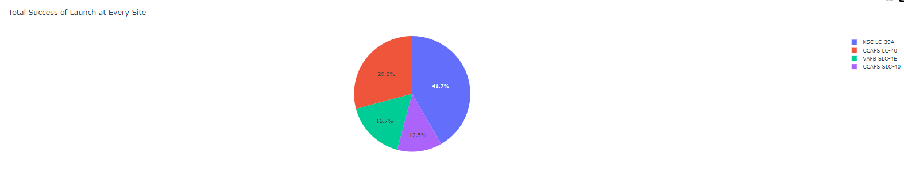
Success Count for All Sites
“KSC LC-39A” Launch Site has the most success count, while “CCAFS SLC-40” site has the lowest success count. However there are differences in the number of total launches in the sites, so higher total launch may contribute to higher success rate but at the same time the fail rate might be high as well.

Slide 39
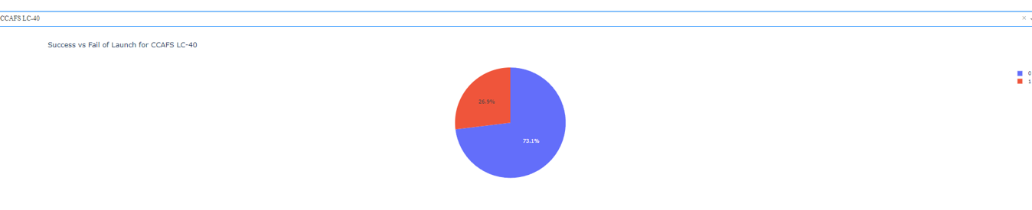
Site with highest success ratio

Slide 40
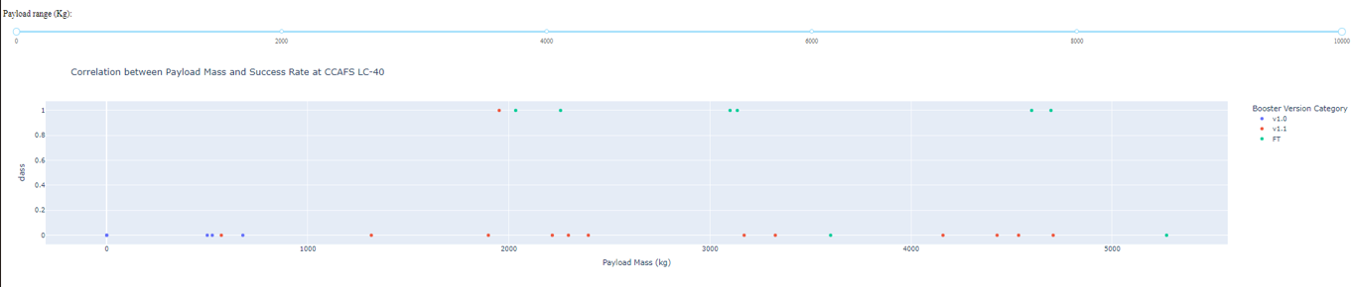
Relation between Payload Mass and Launch Outcome
FT booster has highest success rate. But it cannot be determine the effects of payload mass on success rate

Slide 41

Section 5

Slide 42
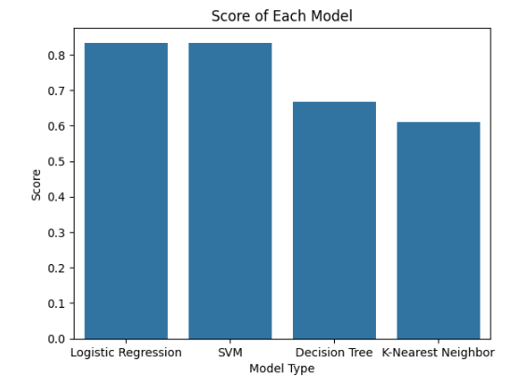
Classification Accuracy
Logistic Regression and SVM have highest accuracy at 83.3%

Slide 43
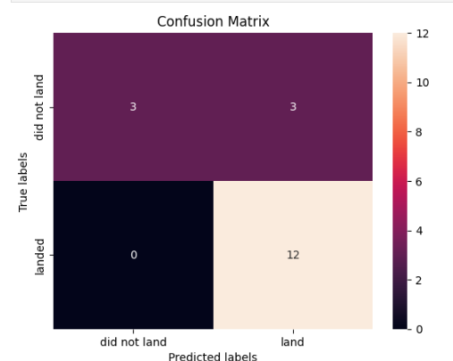
Confusion Matrix
Confusion Matrix of Logistic Regression Model.
12 are correctly predicted as successful (True Positive)
3 are predicted as successful but actually are not (False Positive)
3 are correctly predicted as fail (True Negative)
0 are predicted as fail but actually are successful (False Negative)

Slide 44
Conclusions
Logistic Regression Model can be chosen for determining whether a future rocket launch’s first stage can successfully be reused to determine the cost of operation

Slide 45
Appendix
Link to GITHUB:
https://github.com/dannysuradja/test/blob/main/jupyter-labs-eda-sql-coursera_sqllite.ipynb
https://github.com/dannysuradja/test/blob/main/jupyter-labs-spacex-data-collection-api.ipynb
https://github.com/dannysuradja/test/blob/main/edadataviz.ipynb
https://github.com/dannysuradja/test/blob/main/jupyter-labs-webscraping.ipynb
https://github.com/dannysuradja/test/blob/main/lab_jupyter_launch_site_location.ipynb
https://github.com/dannysuradja/test/blob/main/labs-jupyter-spacex-Data%20wrangling.ipynb

Slide 46


